Slide 1
ADVENTURE WORKS TABLEAU DASHBOARD
-BY GROUP 2

Slide 2

Agenda
Introduction
Dashboard
Conclusion

Slide 3

Introduction
Multinational cycle manufacturing company.
Metal and composite bicycles to the commercial markets.
Aim:
Increase its market share.
Expanding product availability via an outside website.
Cutting production expenses to lower sales prices.

Slide 4
DASHBOARD 1
ADVENTURE WORKS

Slide 5
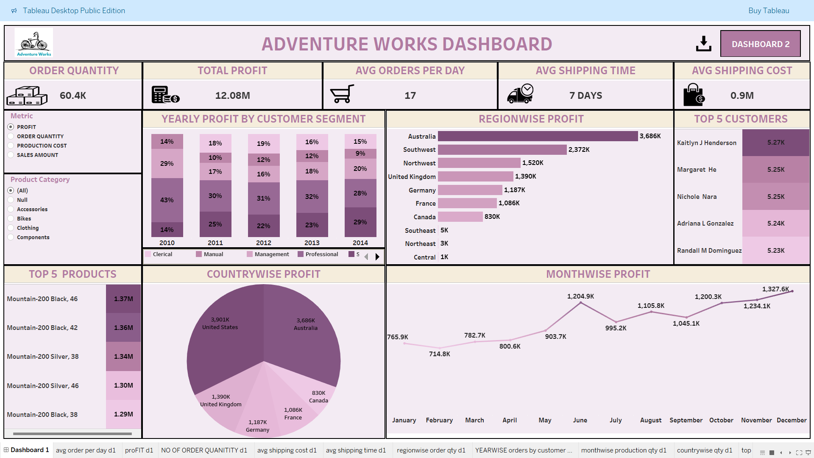

Slide 6
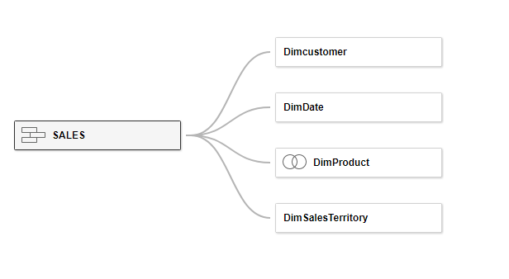
Relationship between tables
Union for sales and sales new table
Inner joins for product tables

Slide 7
Different types of visuals
Bar chart
Column chart
Pie chart
Line chart
KPI
Top performing products and customers

Slide 8
CONCLUSION
Reducing cost of sales
Prioritize marketing efforts
Optimize inventory
Extending products availability
Targeting best customers

Slide 9
Dashboard 2
SALES PERFORMANCE ANALYSIS

Slide 10
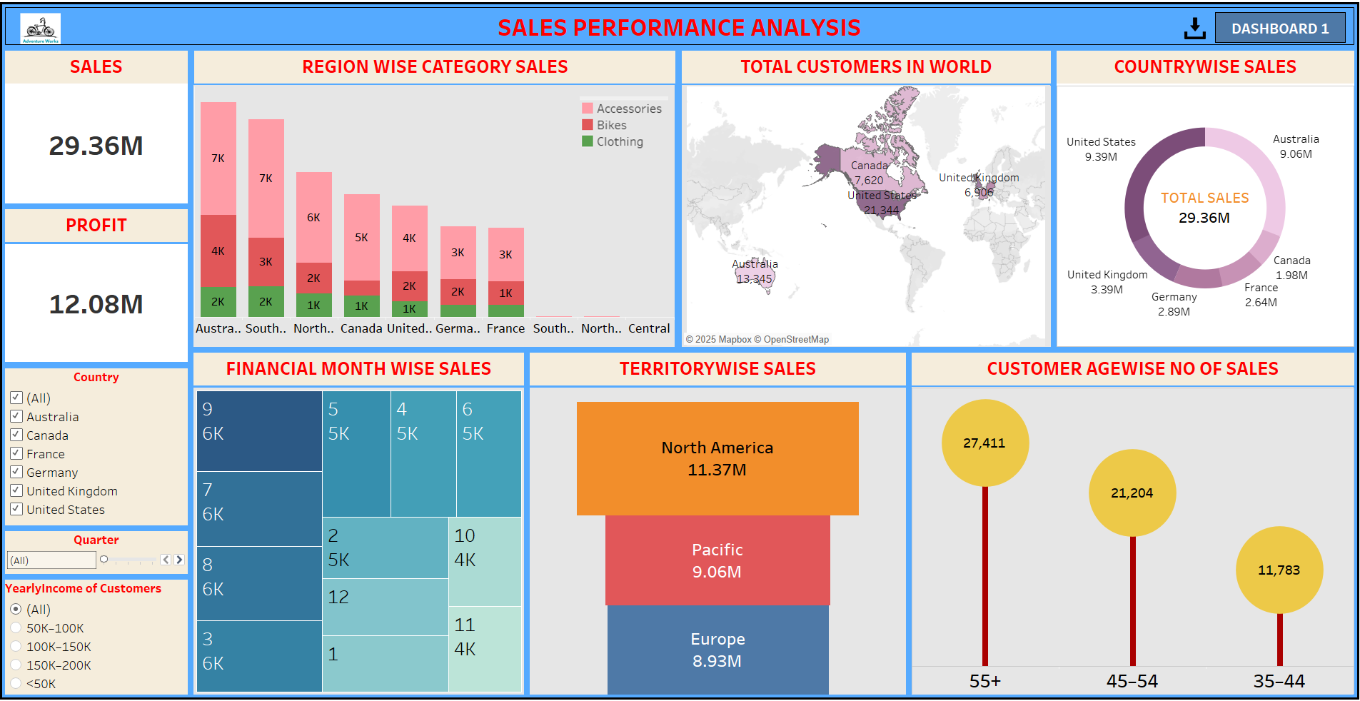

Slide 11
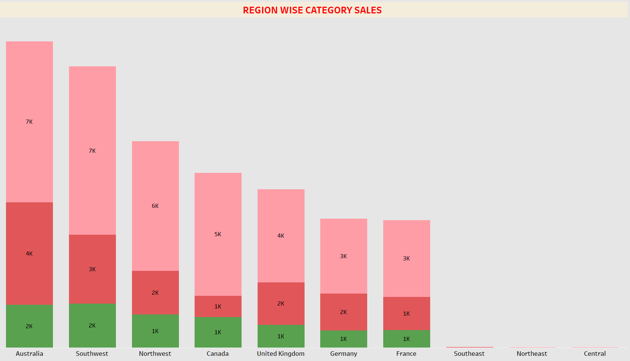
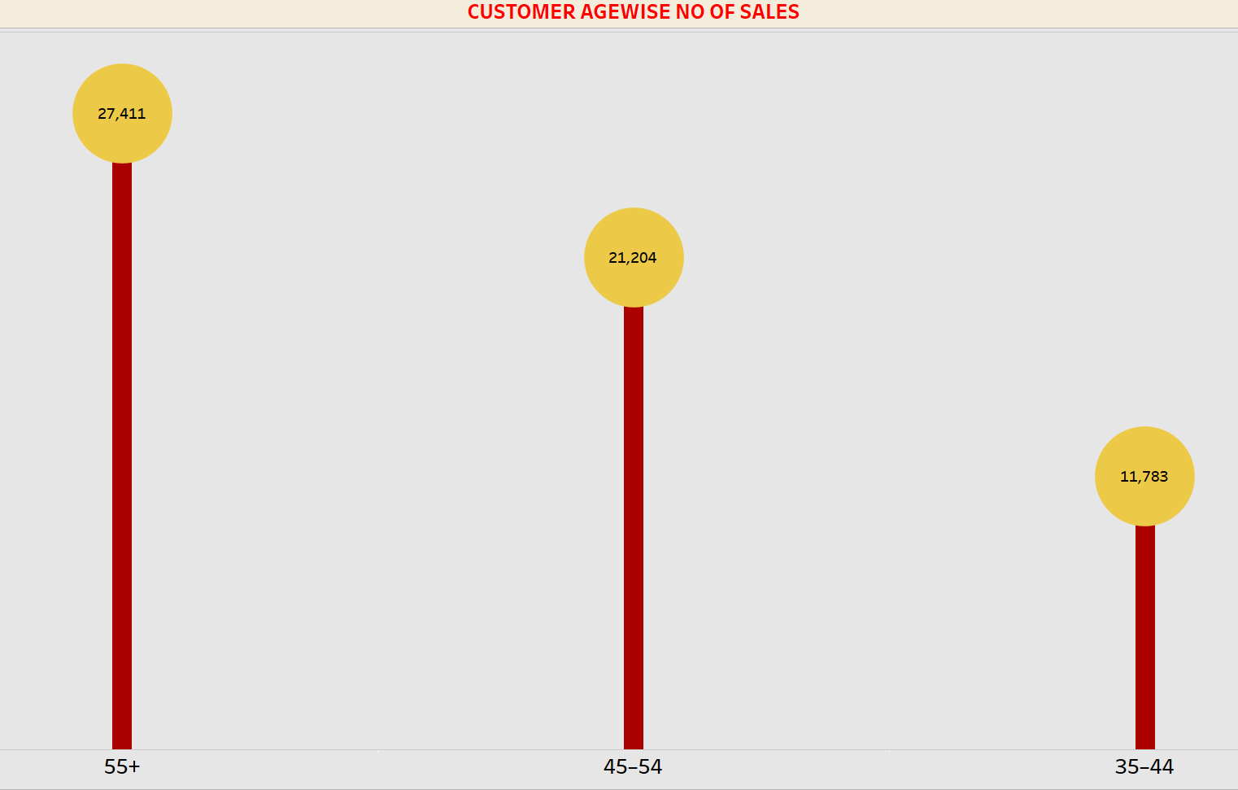
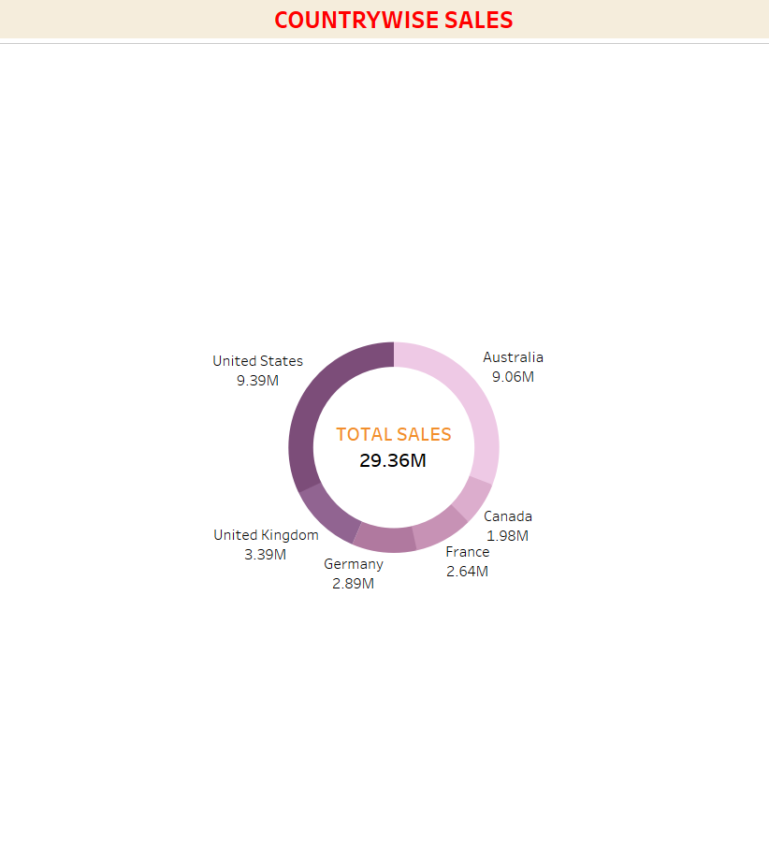
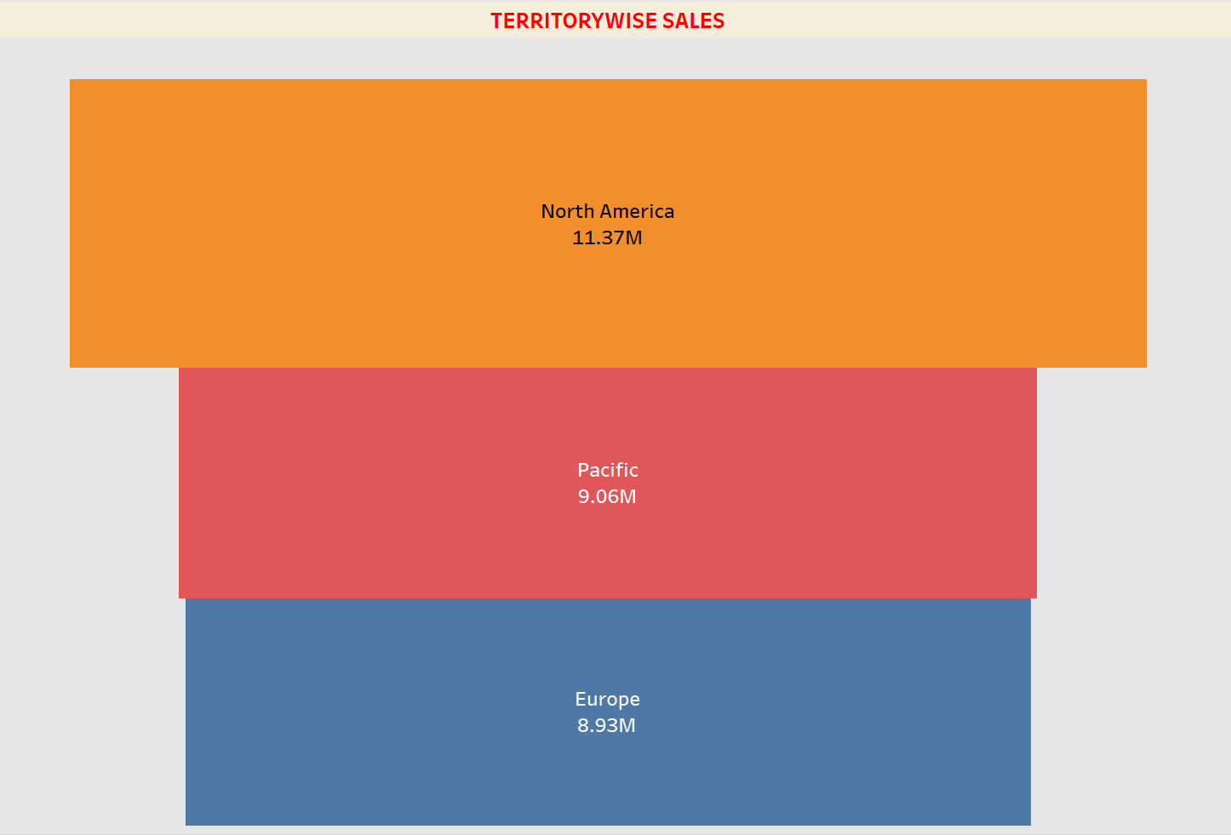
Different type of visuals
Bar chart
Field map
Donut chart
Tree map
Lolli Pop chart
Funnel chart
KPI

Slide 12
CONCLUSION
Top Performing Region $ Countries
Customer Demographics
Category Performance
Geographical Insights
Financial Trends

Slide 13
Thank you
-Group 2

